Slide 1


ESP32-Based Networked Voice Assistant with Remote LLM Inference

Slide 2




PROBLEM STATEMENT
AI Voice Assistant
"Existing voice assistants are expensive and cloud-dependent. Affordable, customizable alternatives for developers and hobbyists are critically needed."
Context :
Commercial assistants (Alexa, Google) lack customization and privacy control
Expensive hardware limits experimentation and learning
No open platforms for personalized AI voice interactions

Slide 3
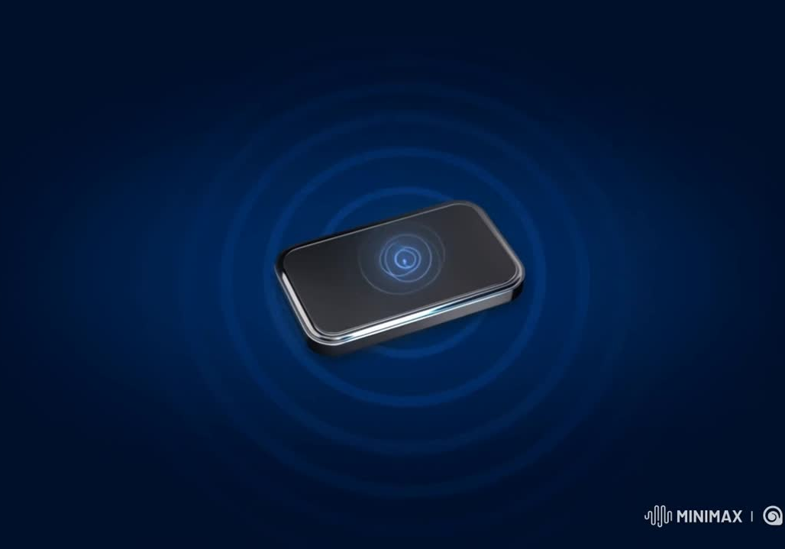
PROJECT OVERVIEW
What we built :A compact voice-assistant device that combines low-cost ESP32 hardware with powerful remote LLM processing to enable advanced conversational AI at under low cost
Key Capabilities:
Real-time voice capture and playback
Natural language conversations via remote LLM (Qwen-3)
Configurable AI personalities and roles
Easy Wi-Fi provisioning and setup
Privacy option through self-hosted servers

Slide 4
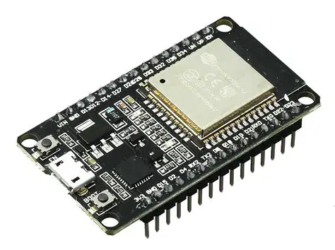
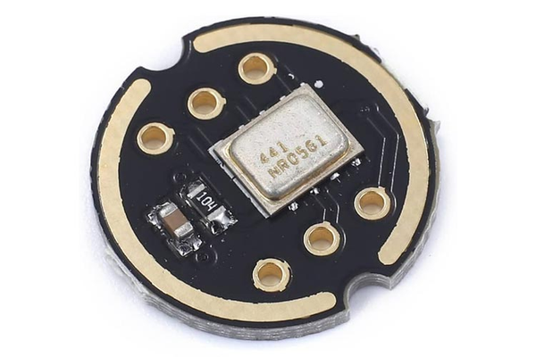
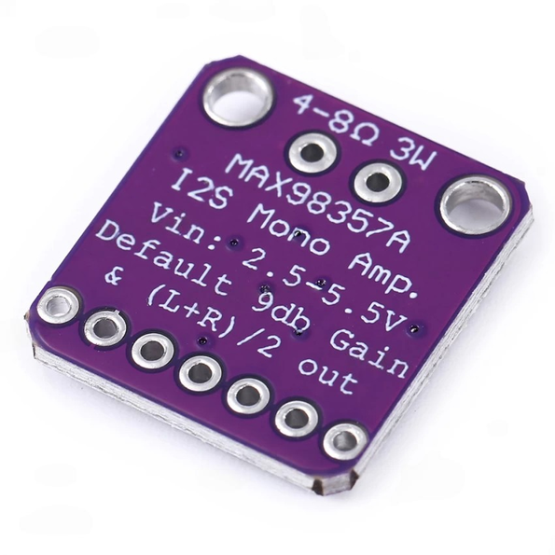
HARDWARE COMPONENT & CORE SYSTEM
Problem Statement: "Building voice AI requires integrating multiple specialized components: microcontroller, audio input/output, and user interface within tight power budgets."
Three Key Hardware Components:
ESP32 DevKit v1 - Main microcontroller with Wi-Fi connectivity, handles audio processing, network communication, and device management without requiring expensive PSRAM
INMP441 Digital Microphone- I²S MEMS microphone captures high-quality audio with >60dB SNR, connects directly to ESP32 via digital interface for clean signal transmission
MAX98357A Audio Amplifier- I²S digital amplifier drives 3W speaker for clear TTS playback, eliminates analog noise with all-digital audio path from ESP32 to speaker

Slide 5
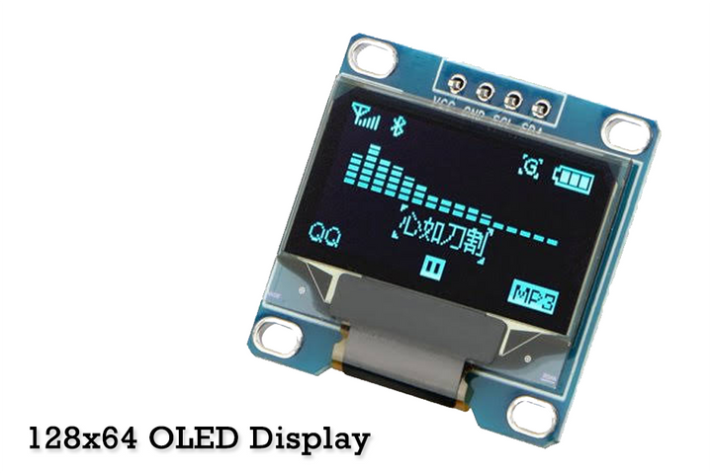
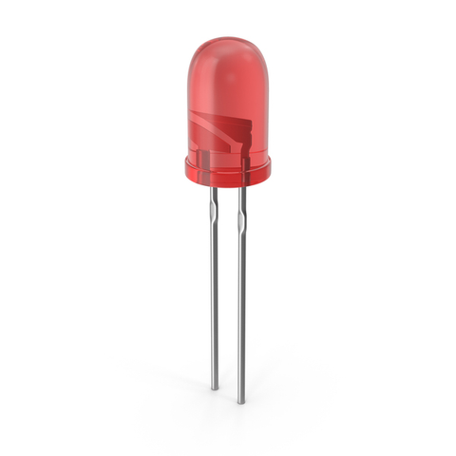
ADDITIONAL COMPONENTS
SUPPORTING HARDWARE:
Display & Feedback:
OLED Display (128×64 or 128×128): Shows status, transcriptions, responses
Status LED (GPIO18): Visual indicator during voice interactions
User Controls:
Boot Button: Wake trigger for voice commands
Reset Button: Hardware reset functionality
Optional:
MicroSD Card: Local logging and firmware storage
External Antenna: Enhanced Wi-Fi reception for weak signal environments

Slide 6
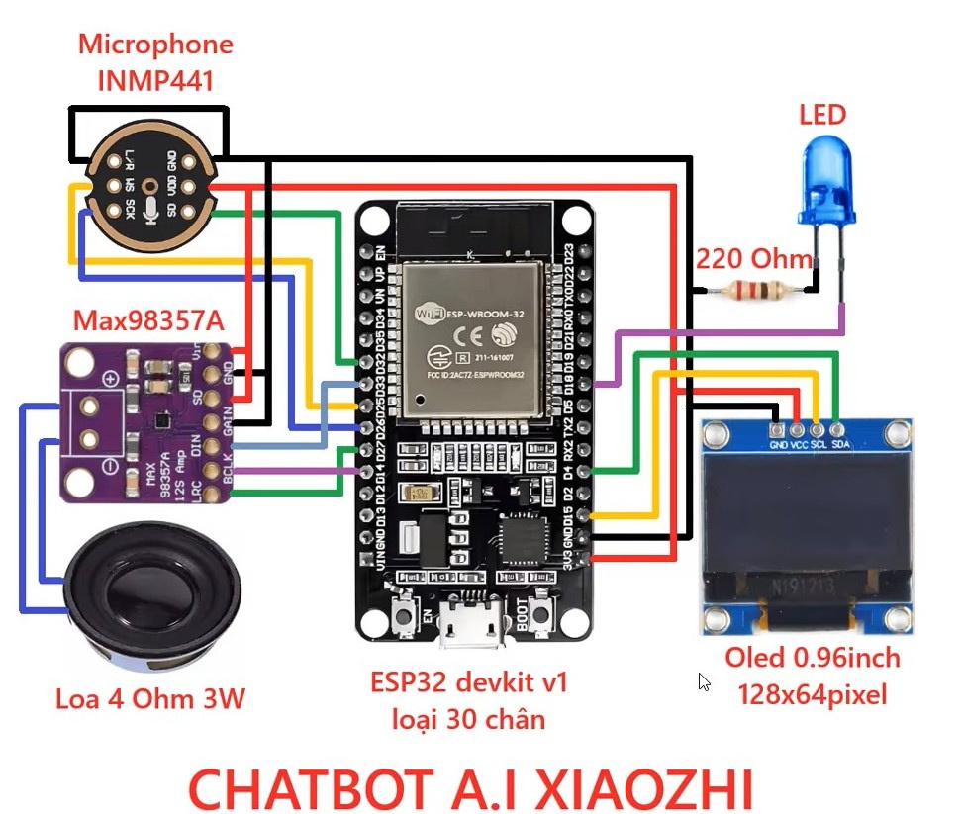
SYSTEM ARCHITECTURE

Slide 7
PIN CONFIGURATION
Function | ESP32 GPIO
I²S WS | GPIO25
I²S SCK | GPIO32
I²S SD | GPIO33
I²S BCLK | GPIO18
I²S LRCLK | GPIO19
I²S DIN | GPIO23
Status LED | GPIO18
OLED | I2C/SPI PINS

Slide 8
SYSTEM ARCHITECTURE- OVERVIEW
ARCHITECTURE FLOW EXPLAINED:
STEP 1: AUDIO CAPTURE USER PRESSES WAKE BUTTON → ESP32 ACTIVATES INMP441 MICROPHONE → RECORDS 3 SECONDS OF SPEECH AT 16KHZ → BUFFERS AUDIO IN MEMORY
STEP 2: NETWORK TRANSMISSION AUDIO COMPRESSED/PACKAGED → SENT VIA WEBSOCKET/MCP PROTOCOL OVER WI-FI → REACHES XIAOZHI BACKEND SERVER (CLOUD OR LOCAL)
STEP 3: AI PROCESSING SERVER PERFORMS SPEECH-TO-TEXT → SENDS TEXT TO LLM (QWEN-3) WITH PERSONALITY CONTEXT → LLM GENERATES RESPONSE → TEXT-TO-SPEECH CREATES AUDIO
STEP 4: RESPONSE PLAYBACK TTS AUDIO STREAMS BACK TO ESP32 → DECODED AND SENT TO MAX98357A VIA I²S → SPEAKER PLAYS RESPONSE → LED INDICATES SPEAKING STATUS

Slide 9
SYSTEM BLOCK DIAGRAM
VISUAL FLOW
USER VOICE
↓
INMP441 MIC→I²S PROTOCOL→ESP32
↓
WI-FI NETWORK
↓
XIAOZHI SERVER
• SPEECH-TO-TEXT
• LLM (QWEN-3)
• TEXT-TO-SPEECH
↓
WI-FI NETWORK
↓
ESP32 → I²S PROTOCOL→ MAX98357A → SPEAKER
↓
OLED DISPLAY & LED

Slide 10


KEY FEATURES AND INNOVATIONS
1. Zero-Code Provisioning
Device creates its own Wi-Fi access point (192.168.4.1)
Simple web interface for network setup
No hardcoding credentials in firmware
2. Configurable AI Personalities
Role files define assistant behavior, language, voice
Switch between expert tutor, storyteller, companion modes
Memory persistence across sessions
3. Reproducible Deployment
Detailed flashing procedure (offset 0x0, baud 921600, 40MHz)
Complete wiring documentation with pin mappings
CP210x driver guidance for Windows compatibility
4. Privacy-First Option
Self-hosted xiaozhi-esp32-server deployment
All data stays on local network
No cloud dependencies required

Slide 11
IMPLEMENTATION CHALLENGES & SOLUTIONS
Challenge 1: MAX98357A GAIN Pin Short
Problem: Some modules short to ground when GAIN pin connected
Solution: Leave GAIN floating, document in troubleshooting guide
Result: 100% boot success rate after mitigation
Challenge 2: Weak Wi-Fi on DevKit v1
Problem: PCB antenna has poor reception in some variants
Solution: Recommend DevKit v4, external antenna, or repeater options
Result: Reliable connection with documented alternatives
Challenge 3: Memory Constraints (No PSRAM)
Problem: ESP32 DevKit v1 lacks external RAM for audio buffering
Solution: Optimized firmware with efficient I²S DMA and streaming
Result: Stable operation with 3-second audio captures

Slide 12
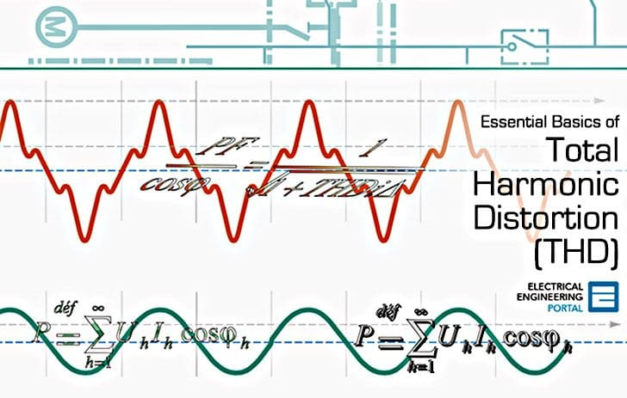
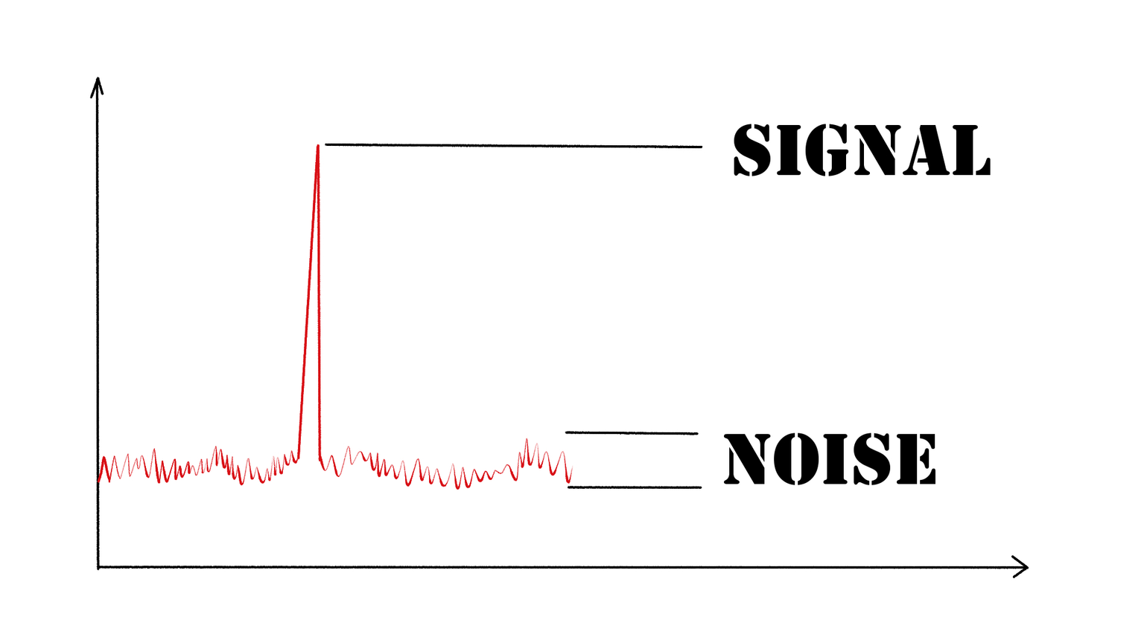
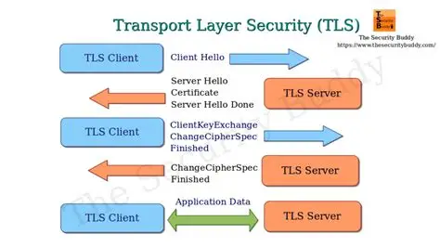
TECHNICAL SPECIFICATIONS
Audio Performance:
Capture SNR: >60 dB
Playback THD: <1% at nominal volume
Wake Latency: <300ms from button press
Round-trip Response: <3 seconds
Network & Power:
Protocol: WebSocket/MCP over Wi-Fi
Security: TLS support, token-based authentication
Power: 3.3V operation, ~500mA peak during playback
Software Stack:
Firmware: xiaozhi-esp32 compatible
Backend: Qwen-3 LLM with configurable TTS
Platform: ESP-IDF based with I²S drivers

Slide 13
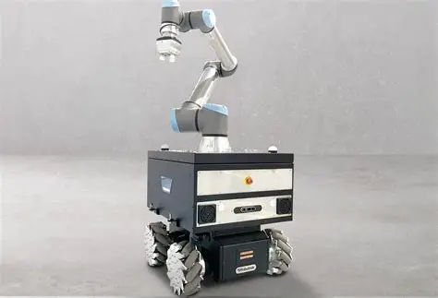

APPLICATION & USE CASE
Current Implementations:
1. Bedside Companion
Sleep stories and meditation guidance
Natural alarm and timer setting
Night-time queries without screens
2. Educational Lab Demo
Teachable AI personality switching
Hardware/software integration learning
IoT protocol demonstrations
3. Robotics Integration
Mobile robot voice control
Sensor data verbal feedback
Autonomous assistant behaviors
4. Future Potential:
Smart home voice nodes (multiple rooms)
Accessibility devices for vision-impaired users
Language learning conversational partners

Slide 14
RESULTS & CONCLUSION
IMPACT:
DEMOCRATIZES AI VOICE TECHNOLOGY FOR MAKERS AND STUDENTS
PROVIDES PRIVACY-RESPECTING ALTERNATIVE TO COMMERCIAL ASSISTANTS
OPEN PLATFORM FOR RESEARCH AND CUSTOMIZATION
FUTURE WORK:
WAKE WORD DETECTION (ON-DEVICE KEYWORD SPOTTING)
MULTI-LANGUAGE SUPPORT EXPANSION
BATTERY-POWERED PORTABLE VERSION
INTEGRATION WITH MORE LLM BACKENDS
REPOSITORY & RESOURCES:
DOCUMENTATION: COMPLETE WIRING GUIDES, BOM, TROUBLESHOOTING
COMMUNITY: ACTIVE FORUMS FOR SUPPORT AND MODIFICATIONS

